Slide 1
GIS software's related to environments and nature hazards

Slide 2
Introduction to natural hazards
Natural hazards include
geological (e.g., earthquakes and landslides)
meteorological events such as cyclones, tornadoes, hailstorms, floods, droughts, and wildfires.

Slide 3
Natural hazards are deeply linked to :
the concepts of magnitude
geographical location
and time recurrence
which denote intensity, place of potential occurrence, and frequency of the natural phenomenon respectively

Slide 4
Why is GIS used in this field
Mitigating the effects of natural hazards and providing potential risk analysis for communities are common application areas for GIS. Information from a central database can be visualized and analyzed to mitigate areas that are environmentally at risk.
You can use GIS to assess contamination of soil, water, or the atmosphere.
Since many factors can play an important role in the occurrence of a natural disaster and their spatial information is crucial to risk assessment and management, the analysis of natural hazards greatly benefits from GIS.

Slide 5
BENEFITS OF GIS WHEN LINKED TO NATURAL HAZARD :
The use of GIS to manage and understand complex natural hazards in spatial and temporal contexts is nowadays
essential.
With GIS, you can :
Monitor pollution to environment relationships.
Identify potential risks.
Prioritize potential pollution scenarios.
Model the rise of pollution levels over time and predict environmental impact.

Slide 6
Disaster monitoring and early warning

Slide 9
Techniques :

Slide 11


Slide 13
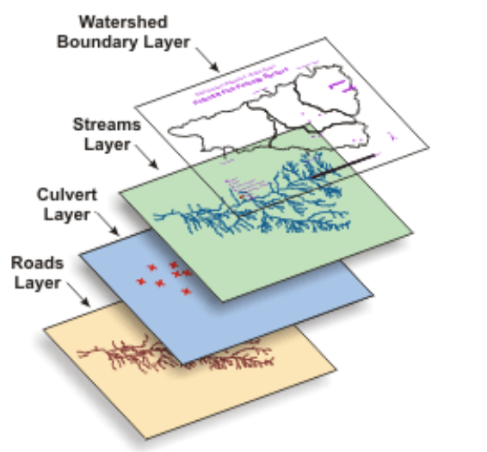
Case study :
Honduras: Jesús de Otoro Valley, Department of Intibuca
Identification of flood- and erosion-prone areas for the selection of agricultural production projects.
- Presented land use
- Projected land use
- Soils
- Human settlements
- Floodplains
Erosion risk
Development strategy
66 percent of the land presently occupied or planned for irrigated agriculture investment was found to be in flood-susceptible areas

